Slide 1
Combined Volunteer Team Meeting
11th May 2025
Dr. Kumar Sambhav
Updated overview of UHV-I material version 2
Details of sessions 8-15 with Q&A
Sh. Rajul Asthana
Updated UHV-I project
Mentor Manual (incl How to share UHV-I)

Slide 2
Combined Volunteer Team Meeting
4th May 2025
Sharing team (lead volunteers and inputters) for further refinement of UHV-I (project)
Overview of UHV-I material version 2
Details of sessions 1-7 with Q&A

Slide 3
Project P6.A Refine UHV-I
Input: UHV-I v2 and UHV-I Mentor Manual v2.1
  Review and update the pre and post survey, polls, quizzes and test – by 31 May 2025
  Review and update UHV-I v2 to include practice sessions, activities, role plays, workbook… (Gather and consider feedback of faculty volunteers who conduct UHV-I v2)
  Update UHV-I Mentor Manual v2.1
Target: Release UHV-I v3 and UHV-I Mentor Manual v3 by March 2026
  Optional: Develop a free, publicly available video-based self-learning UHV-I course for an international audience (may use technology platforms like Moodle, EduX, SWAYAM, etc.)
Guides: Kumar Sambhav, Rajul Asthana, Umesh Jadhav, Gopal Babu, Bhanu Pratap Singh
Lead Volunteers: Jagadeesh Babu Bellam, Nidhi Chirag, +1 (technology lead TBD)
Inputters/Volunteers: Sunilkumar N, Yashwant Patil, Ajay Pal Singh, Lipika Mitra, Anita Mane, Priyadarshini, Vinay Chidri, Manisha Gupta…

Slide 4
Volunteers interested in project P6.A Refine UHV-I
P6.A
ARUN KUMAR PANDEY
Deepa G Nair
Dr Alok Kumar Soni
Dr Parul Verma
Dr S. Ushakumari
Dr Seema Patel
Dr. Anupam De
Himanshu Kumar Dwivedi
Jagadeesh Babu Bellam
Lipika Mitra
Navin Kumar Sharma
Prabhat Kumar Yadav
Raghvendra Dubey
Ranjeeta Ghosh
Soumya S
Vijayashree T

Slide 5
Overview of
UHV-I in Student Induction Program

Slide 6
What is included in this Presentation (and documented in the UHV-I Mentor Manual)
The Student Induction Initial 21 days
Program UHV-I is the core module
Faculty Mentorship One UHV faculty mentor (guardian, guide from same department)
Program for every 20 newly joined students
Weekly interaction
Mentorship throughout period of study (e.g., 4 years for BTech)
Student Buddy Program One senior student (elder sibling)
for every 5 newly joined students
Weekly interaction
The UHV-I Module 15 facilitator-led discussions of 1½ hours each (total 22½ hours)
How to Conduct UHV-I
Resources
UHV-I is intended to provide a glimpse of universal human values,
and help the student explore that going by human values leads to fulfilment of right aspirations and the resolution of concerns, ultimately living with fulfilment (in all aspects of life)

Slide 7
Student Induction Program – Context
New entrants go through years of strenuous preparation and get accustomed to it.
Often they lose the connection from social life and recreational activities
On the other hand, higher education, like engineering, demands a personality in all dimensions
The Student Induction Program is designed for a smooth transition
from school, preparation environment to higher education
Preparation
Education Program
Induction
For Initial 21 Days
UHV Cell
For Remaining Years

Slide 8
Goals of SIP
To become familiar with the ethos and culture of the new surroundings
To develop bonds with peers, seniors, faculty and staff
To provide an exposure to a holistic vision of life (based on larger national and human good; or the well-being of all)
Develop awareness, sensitivity and understanding of the
Self---family---Society---Nation---International---Entire Nature
To develop a healthy lifestyle and ethical professional discipline
To connect and appreciate the diversity of cultures
To overcome weaknesses in some essential professional skills to be ready for higher study (only for those who need, e.g., mathematics, languages/communication)

Slide 9
Universal Approach
All the SIP activities (modules) are based on generic and universal principles
Local, regional, national and international examples are taken so that students can relate them to their day to day life
  For example, module 2 is about “physical health and related activities”. In this, we will be talking about “holistic human health” which is generic and universal. To exemplify this, we may take the example of Ayurved.
  For example: We want to live with fulfilment as a society. This part is common, universal. To exemplify this, we may expose students to traditional Indian culture and philosophy as well as contemporary western culture
In this way:
  It will help in connecting the basic principles through specific examples
  It will help the student to see and appreciate various cultures, to see the commonality amongst them
  It will help to evaluate any specific example, system or culture, with a view to fill the gaps, rather than to criticise or reject it. Further, we can also be mutually enriching for other cultures

Slide 10
Solution Centric Approach
The world today has become a mixture of various cultures
In India, we can see
  Urban / City culture  Western culture
  Liberal culture  Movie/Internet culture
  Traditional rural Indian culture
  and so many others
Today, the problem is that one culture tends to compare with other cultures and be opposed to them. This is because their basic assumptions and therefore thoughts are different. Even though there are commonalities at the core, the conflict is at the level of expression and details
With this situation, it is imperative to
  Appreciate the different approaches and achievements
    (to whatever extent a culture has realised the basic human values of truth, love and compassion at the core)
  Be complimentary, help to fill the gaps, rather than to compare, criticise or reject

Slide 11

Inaugural Ceremony ~2 hours
M1: Universal Human Values I (UHV-I) 15-25
M2: Physical Health and Related Activities 35-50
M4: Visit to a Local Area 03-05
M5: Lectures by Eminent People 02-05
M7: Literature / Literary Activities 15-30
M8: Creative Practices 30-36
M9: Other co-curricular Activities 05-10
M3: Familiarization of Dept/ Branch and Innov 02-05
M6: Proficiency Modules 05-15
Grand Celebration 02-06
SIP Activities
Universal Human Values (UHV) Foundation
Indian Knowledge System (IKS)
including local, regional, national
international examples
focused on wellbeing of all
3 Weeks
Nature friendly and
human friendly skills and
their practice

Slide 12
UHV-I Module
UHV-I is intended to provide a glimpse of universal human values,
and help the student explore that going by human values leads to living a fulfilling life
(in all aspects of life)

Slide 13
UHV Module
In the UHV Module of SIP, the main points to highlight are:
Every student has the possibility to reach to their full potential as a human being
For this, we have to understand
    Ourselves (our aspirations, concerns…), other people, other things around with which we interact…
    Our relationships, our participation – with oneself, with other people, in society, in the entire nature/existence
It is possible to understand – because
    The need to understand is innate in every human being and
    The potential to understand is intrinsic to human being
    The things essential to understand are definite
We will use a process of self-exploration for this… we simply have to pay attention, and explore into the proposals… Let the time in this institution be a time of intense and joyous exploration!
UHV is an exploration into it, so that the student can discover their full human potential, develop a holistic plan for realising it and take steps towards it

Slide 14
UHV Module
Discover our aspirations and articulate our concerns
We can slowly realise that
    We all have the same basic aspirations
    We have to understand to fulfil our aspirations
    We all have some concerns, some problems, These can be different for different students
    To resolve any problem or concern also, we need to understand
The process to understand is simply to pay attention. We can easily do that. We can understand, realise our aspirations and resolve our concerns
    E,g, Find out if it is true that “whatever you have paid attention to has revealed itself to you”. E.g. maths seemed so difficult, but now you know it… because you paid attention to it
In this UHV module, we will go over this process at four levels
    Individual human being, family, society and nature/existence

Slide 15
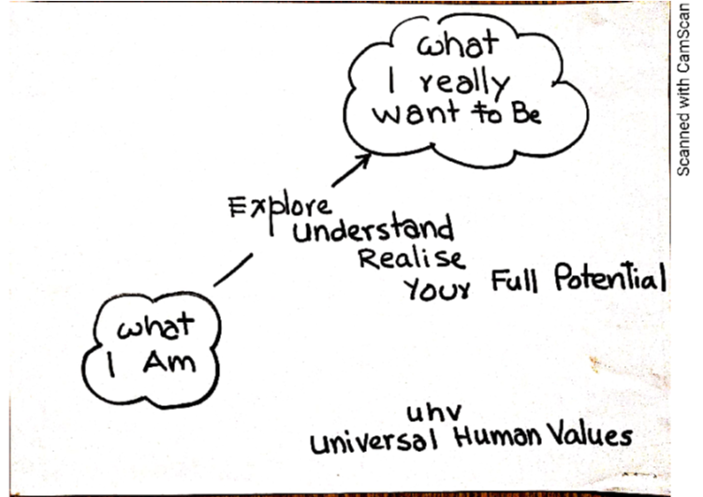
Aspirations (what you want to achieve)
Regarding self, as an individual
About family, friends, other people
Related to society, societal systems
In the natural environment
My Full Potential
Concerns (what you want to get rid of)
Regarding self, as an individual
About family, friends, other people
Related to society, societal systems
In the natural environment

Slide 16
The objectives of the UHV module (UHV-I) are:
To help the student to see the need for developing a holistic, humane world-vision
To sensitise the student about the scope of life
    individual human being
    family (inter-personal relationship)
    society
    nature/existence
Strengthening self-exploration
To develop more confidence and commitment to understand, learn, and act accordingly

Slide 17
UHV-I: An Orientation to Universal Human Values (Understanding the Full Human Potential)
Session | Title | Underlying Reality
Ind 1 | Introduction Welcome, course overview, getting to know each other
Ind 2 | Exploring our aspirations and concerns Planning for a fulfilling life by relating academic success, career… expectations of family, peers… to our basic aspiration… | Basic human aspiration
Ind 3 | Basic human aspiration and its fulfilment Setting correct priorities in life | Human consciousness
Ind 4 | Program for fulfilment of basic human aspiration Shifting from excitement to happiness… | Understanding harmony
Ind 5 | Fulfilment of aspirations at individual level Distinguishing between the needs of Self and Body | Harmony in human being
Ind 6 | Resolution of concerns at individual level Developing self-confidence, overcoming peer pressure | Harmony in the Self
Ind 7 | Ensuring health holistically Making a definite program for health | Harmony between Self and Body

Slide 18
UHV-I: An Orientation to Universal Human Values (Understanding the Full Human Potential)
Session | Title | Underlying Reality
Ind 8 | Fulfilment in relationship – Trust Resolving anger, irritation, fear… | Harmony in family
Ind 9 | Fulfilment in relationship – Trust Shifting from reaction to response in relationship… | Harmony in family
Ind 10 | Fulfilment in relationship – Respect Shifting from differentiation to complementarity… | Harmony in family
Ind 11 | Fulfilment in relationship – Other Feelings Shifting from competition to excellence, infatuation to love… | Harmony in family
Ind 12 | Understanding our role in society Contributing towards fulfilment of a common human goal in the society (institution… state… nation… world) | Harmony in society
Ind 13 | Understanding our role in nature Contributing towards harmony in nature | Harmony in nature/existence
Ind 14 | Sum up and program
Ind 15 | Sharing, self-evaluation

Slide 19
Model Schedule for UHV-I FDP (to prepare faculty to teach UHV-I, Pre-req: UHV-Intro FDP)
Pre Session 8.30-9.00 | Session 1 9.00-10.30 | Session 2 11.00-12.30 | Session 3 13.30-15.00 | Session 4 15.15-16.45 | Session 5 16.50-18.00
Inauguration | Ind 0: UHV-I Overview Ind 1: Introductions Ind 2: Exploring Aspirations and Concerns | Ind 3: Basic human aspiration and its fulfilment Ind 4: Program for fulfilment of basic human aspiration | Ind 5: Fulfilment of aspirations at individual level Ind 6: Resolution of concerns at individual level | Ind 7: Ensuring Health How to Share Values (from Mentor Manual) | Demo Presentations
Sharing, Q&A | Ind 8: Fulfilment in Relationship – Trust Shifting from Reaction to Response | Ind 9: Fulfilment in Relationship – Respect Ind 10: Shifting from Competition to Excellence | Demo Presentations | Ind 11: Fulfilment in Relationship – Gratitude… Love | Demo Presentations
Sharing, Q&A | Ind 12: Understanding Role in Society | Ind 13: Role in the Natural Environment Ind 14: Sum-up & Future Program | Demo Presentations | Ind 15: Self-evaluation | Valedictory Function

Slide 20
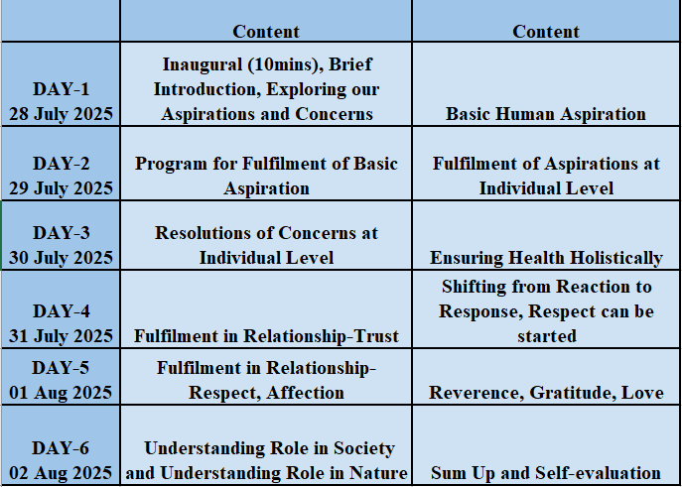
Model Schedule for 6-day online UHV-I SDP (Student Development Program)

Slide 21
General Guidelines
Conduct 15 sessions of 1.5 hours each in face-to-face mode in small groups of 20 students (only if not possible, use larger groups, shorter sessions or online mode)
Most important thing is to connect with the students as a co-explorer, facilitator; encourage exploration (not preach, try to convince, get students to “agree”…)
Connect their real life (aspirations, and concerns) to the core content (basic reality, underlying harmony). This will help students to develop an interest in understanding
Keep the discussion light, live, natural and interactive (not instructive, made-up, artificial…)
Connect previous session to current session and also to overall objective (not independent, unconnected…)
Note your specific suggestions for further refinement (and share with the project team)
More details in UHV-I Mentor Manual

Slide 22
How to Share UHV-I

Slide 23
This Whole Content is Shared thru
UHV Content
Issues in the current situation- solution-focussed, problem-focussed both, Exploring into them to get an understanding of the concerned reality and possible solutions
Basic introduction to human aspiratiion of continuous happiness and its fulfillment through understanding of Harmony at different levels of existence and living accordingly
Understanding Human Being, Nature and Existence in detail.
Vision for a Humane Society- Role of human being and its expression in relationship and system in the Humane Society
Human Values (based on understanding of existential realities) in different philosophies/ traditions in the past and present
Human Psychology- based on the understanding of existential realities as co-existence, harmony, relationship and human being as co-existence of self and body
Human Sociology- based on the understanding of existential realities as co-existence, harmony, relationship and human behaviour as mutual fulfillment with human being and rest of nature
Human Economics- based on the understanding of existential realities as co-existence, harmony, relationship and economics as the process of ensuring nurturing, protectIon and right utilisation of nature (including both human being and rest of nature)

Slide 24
How to Share UHV-I – Suggestions for Faculty
Connect with the students as a co-explorer, share
Place the content as a proposal
Stay with the sequence of interconnected key points, build up to the overall proposal being discussed
Relate the content to life through examples, etc. then recall the proposal
Encourage dialogue about the proposal (vs. the examples)
Respond to questions with the content discussed so far, then recall the proposal being discussed
(do not refer to content that is yet to be shared)
Facilitate self-exploration, so that students can arrive at their own answers (i.e., discover their natural acceptance)

Slide 25
Resources for Preparing

Slide 26
For your Preparation
Materials
UHV-I Presentations v2
UHV-I Mentor Manual v2.1
Surveys, polls, quizzes, test
Videos and Assignments
Recordings on YouTube
Reference Text Book and Teachers’ Manual (available on the website)
Further Activities
Higher Level FDPs
Volunteering
Weekly RP Development Meetings
Weekly Mentor-Mentee Meetings
The Morning Session

Slide 27
UHV-I Materials
Links
AICTE FDP-SI Website https://fdp-si.aicte-india.org/
SIP YouTube Channel https://www.youtube.com/@aicte-sip1598
UHV Website https://www.uhv.org.in/
UHV Youtube Channel https://www.youtube.com/@UniversalHumanValues
Presentations, Surveys and Assignments
https://drive.google.com/drive/folders/1016XJBOvMgE1DqLW2pBsb2r6Izbtqzmu?usp=sharing
Preparing to Share Values
https://www.youtube.com/watch?v=vbvPkZ8X4d8&list=PLWDeKF97v9SOkLsFSULd2l6tQ4PRxyvRo
Hindi Recording
https://www.youtube.com/watch?v=nBdLaFUlO8E&list=PLYwzG2fd7hzeSdsr3W9-8B6mFlx-FIsgB
English Recording
https://www.youtube.com/watch?v=OgdNx0X923I&list=PLYwzG2fd7hzer-n_sVjmtFnuSs_Mph4Bi

Slide 28
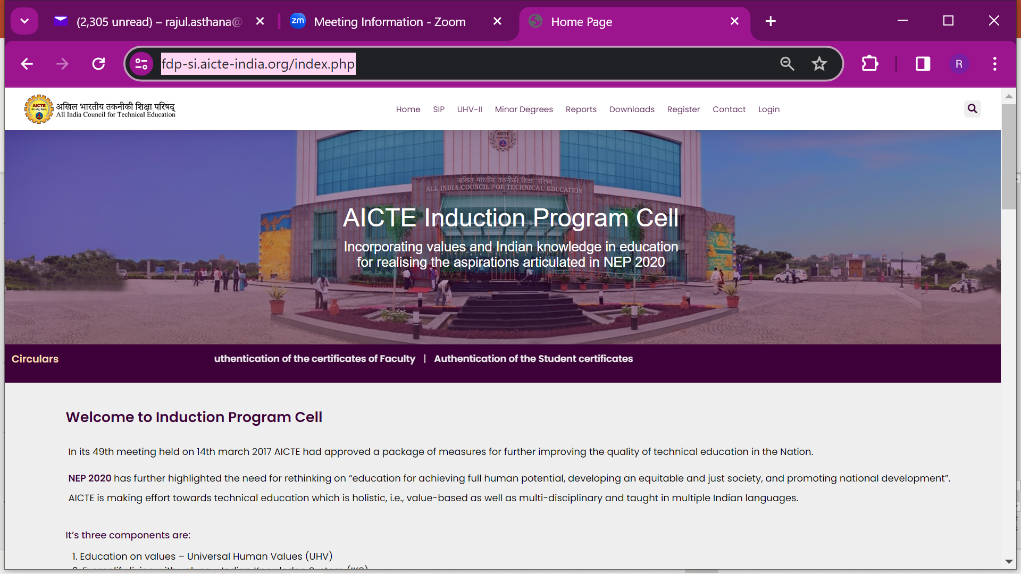
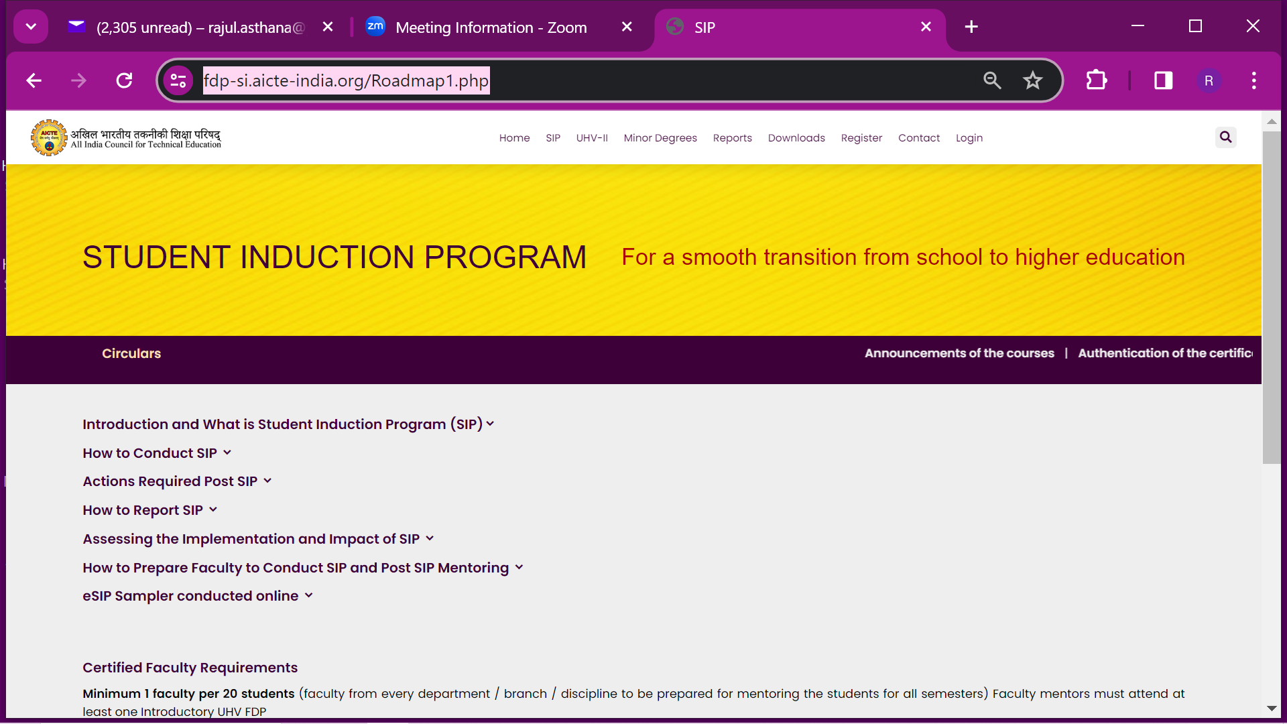
Present AICTE FDP-SI Website
https://fdp-si.aicte-india.org/index.php

Slide 29
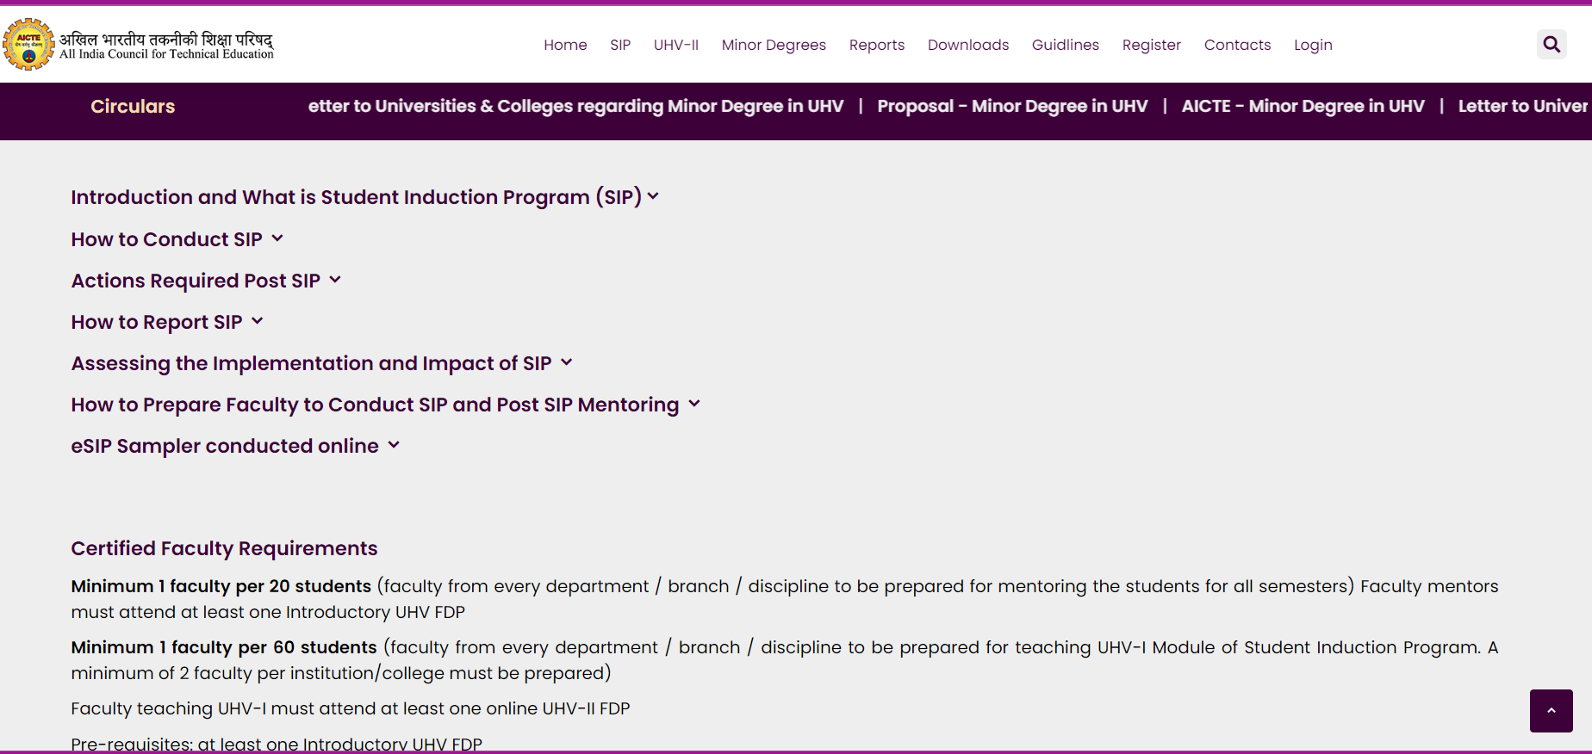
New AICTE FDP-SI Website (under Development)

Slide 30
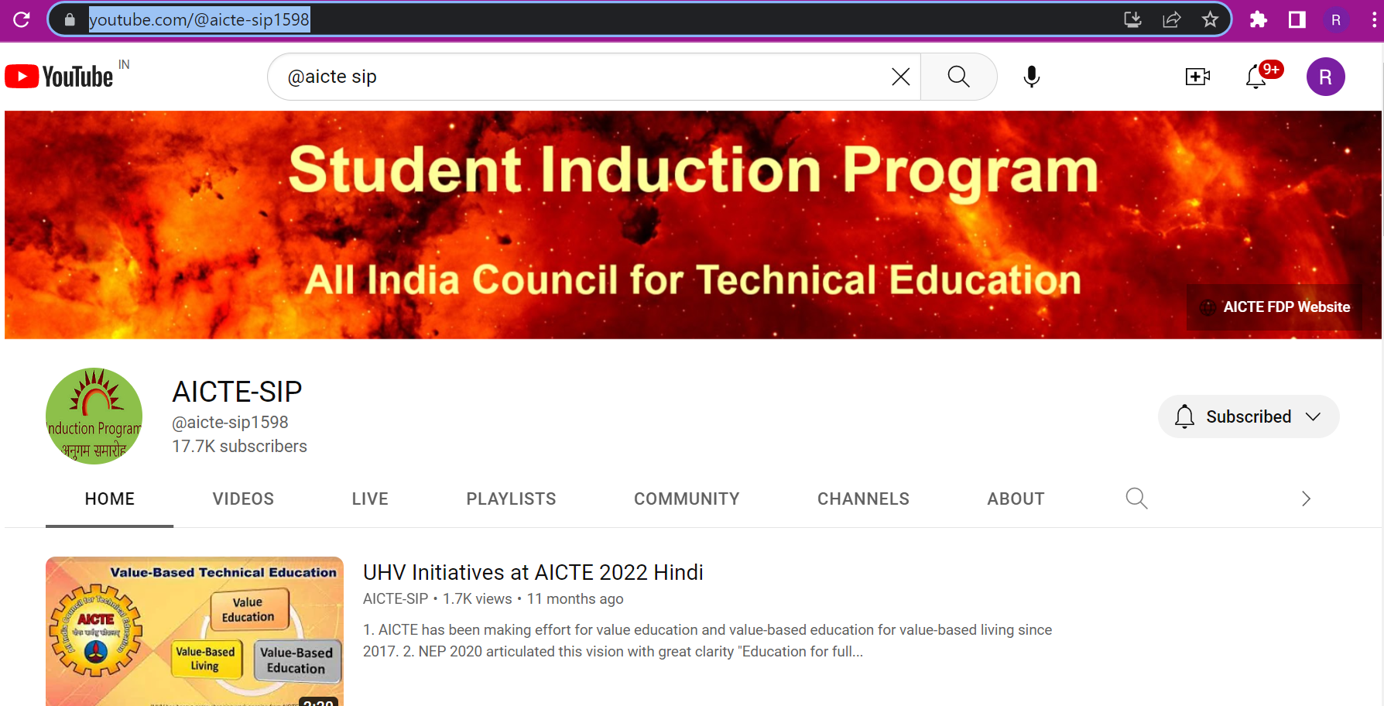
SIP YouTube Channel

Slide 31
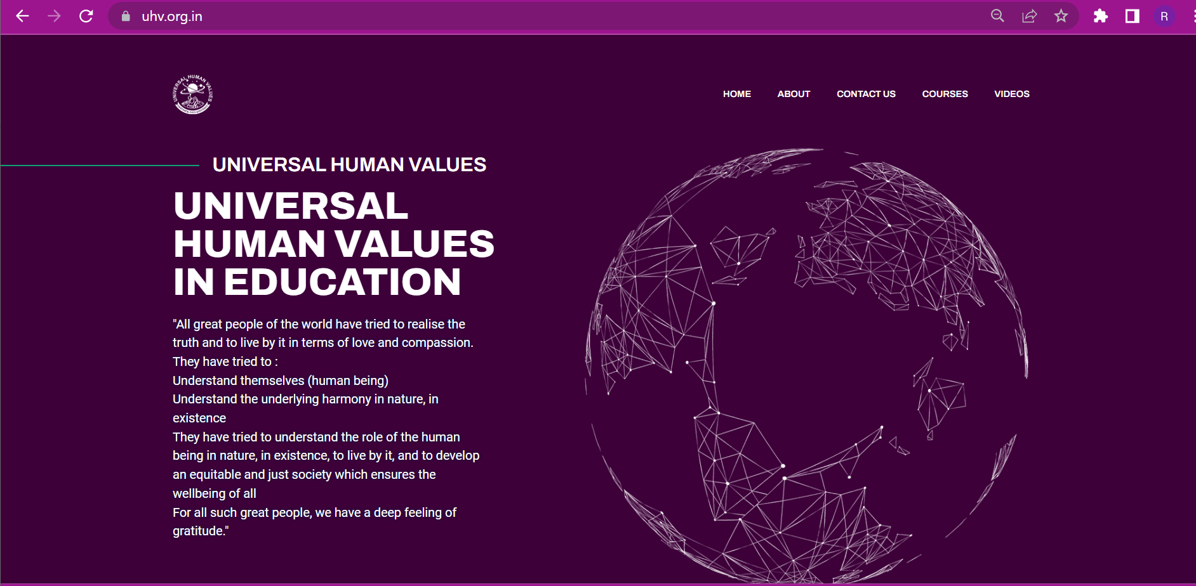
UHV Website

Slide 32
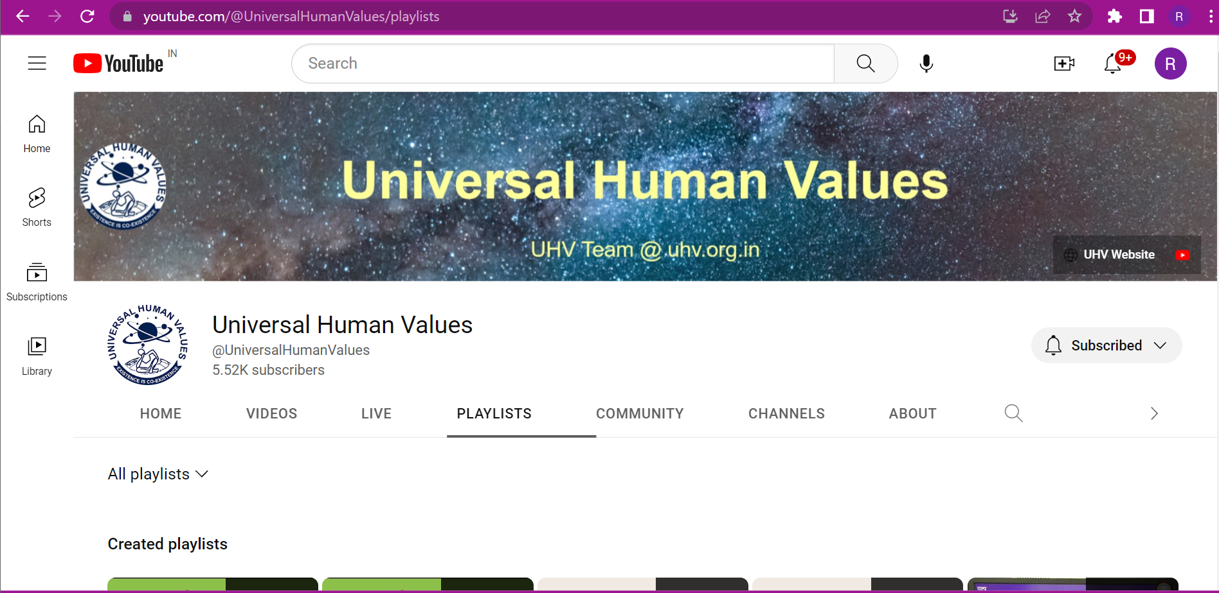
UHV YouTube Channel

